Slide 1


Slide 2

Liver Disease Analysis

Slide 3
Overview
Patients with Liver disease have been continuously increasing because of excessive consumption of alcohol, inhale of harmful gases, intake of contaminated food, pickles and drugs. This dataset was used to evaluate prediction algorithms in an effort to reduce burden on doctors.
About the Dataset
This data set contains 416 liver patient records and 167 non liver patient records collected from North East of Andhra Pradesh, India. The "Dataset" column is a class label used to divide groups into liver patient (liver disease) or not (no disease). This data set contains 441 male patient records and 142 female patient records.

Slide 4
Columns
Age of the patient
Gender of the patient
Total Bilirubin
Direct Bilirubin
Alkaline Phosphotase
Alamine Aminotransferase
Aspartate Aminotransferase
Total Protiens
Albumin
Albumin and Globulin Ratio
Dataset: field used to split the data into two sets (patient with liver disease, or no disease)

Slide 5
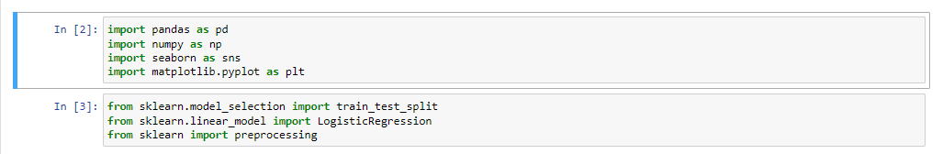
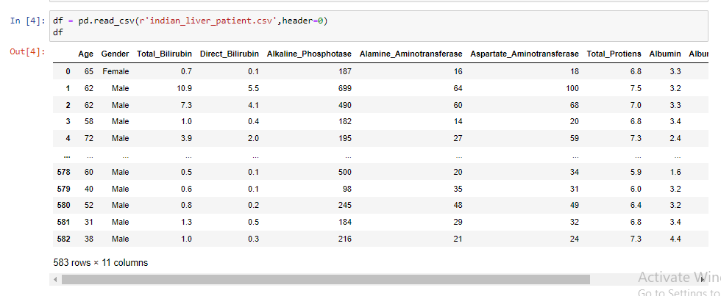
Importing the libraries
Loading the Dataset

Slide 6
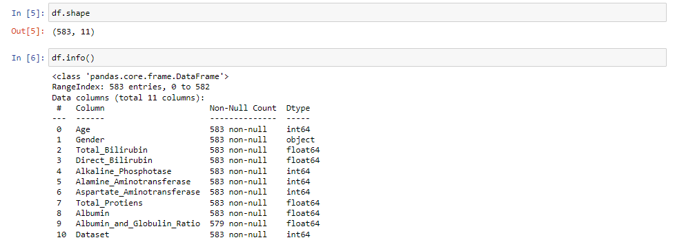
0bservations

Slide 7
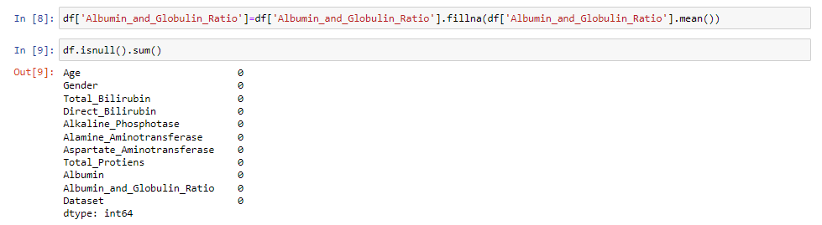
Replacing null values

Slide 8
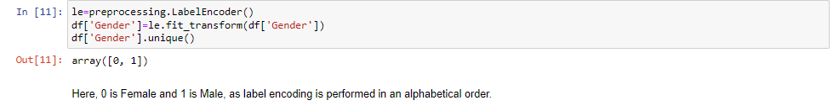
Converting categorical variables into numerical

Slide 9
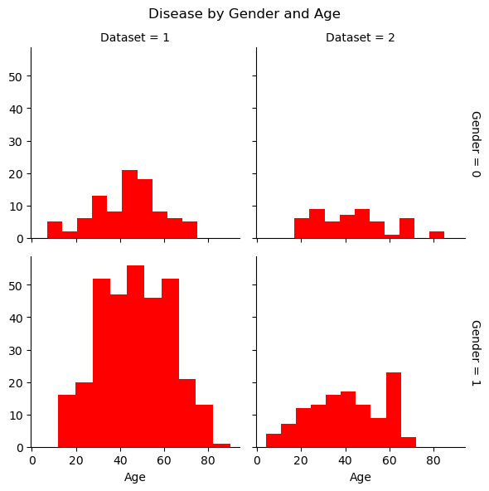
Visualizing the data
As evident, age seems to play an important role in liver diseases in both males and females.

Slide 10
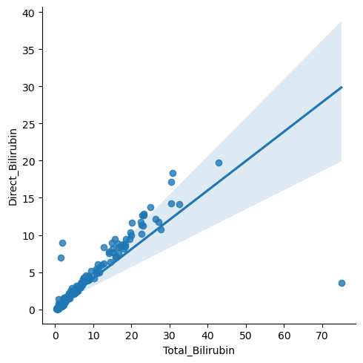
Visualizing the data
There is linear relationship between Direct Bilurubin and Total Biluribin. Hence one variable can be dropped.

Slide 11
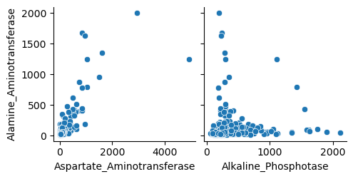
Visualizing the data
There is linear relationship between Alamine and Aspartate Aminotransferase. However, there is no relationship between Alamine Aminotransferase and Alkaline Phosphotase. Accordingly, Aspartate Aminotransferase can be dropped.

Slide 12
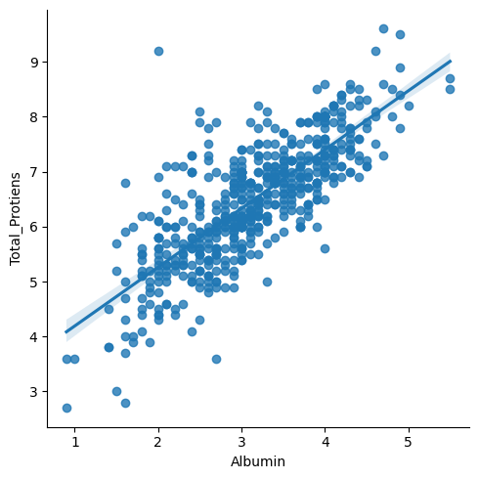
Visualizing the data
There is linear relationship between Total proteins and Albumin. Hence one feature can be dropped.

Slide 13
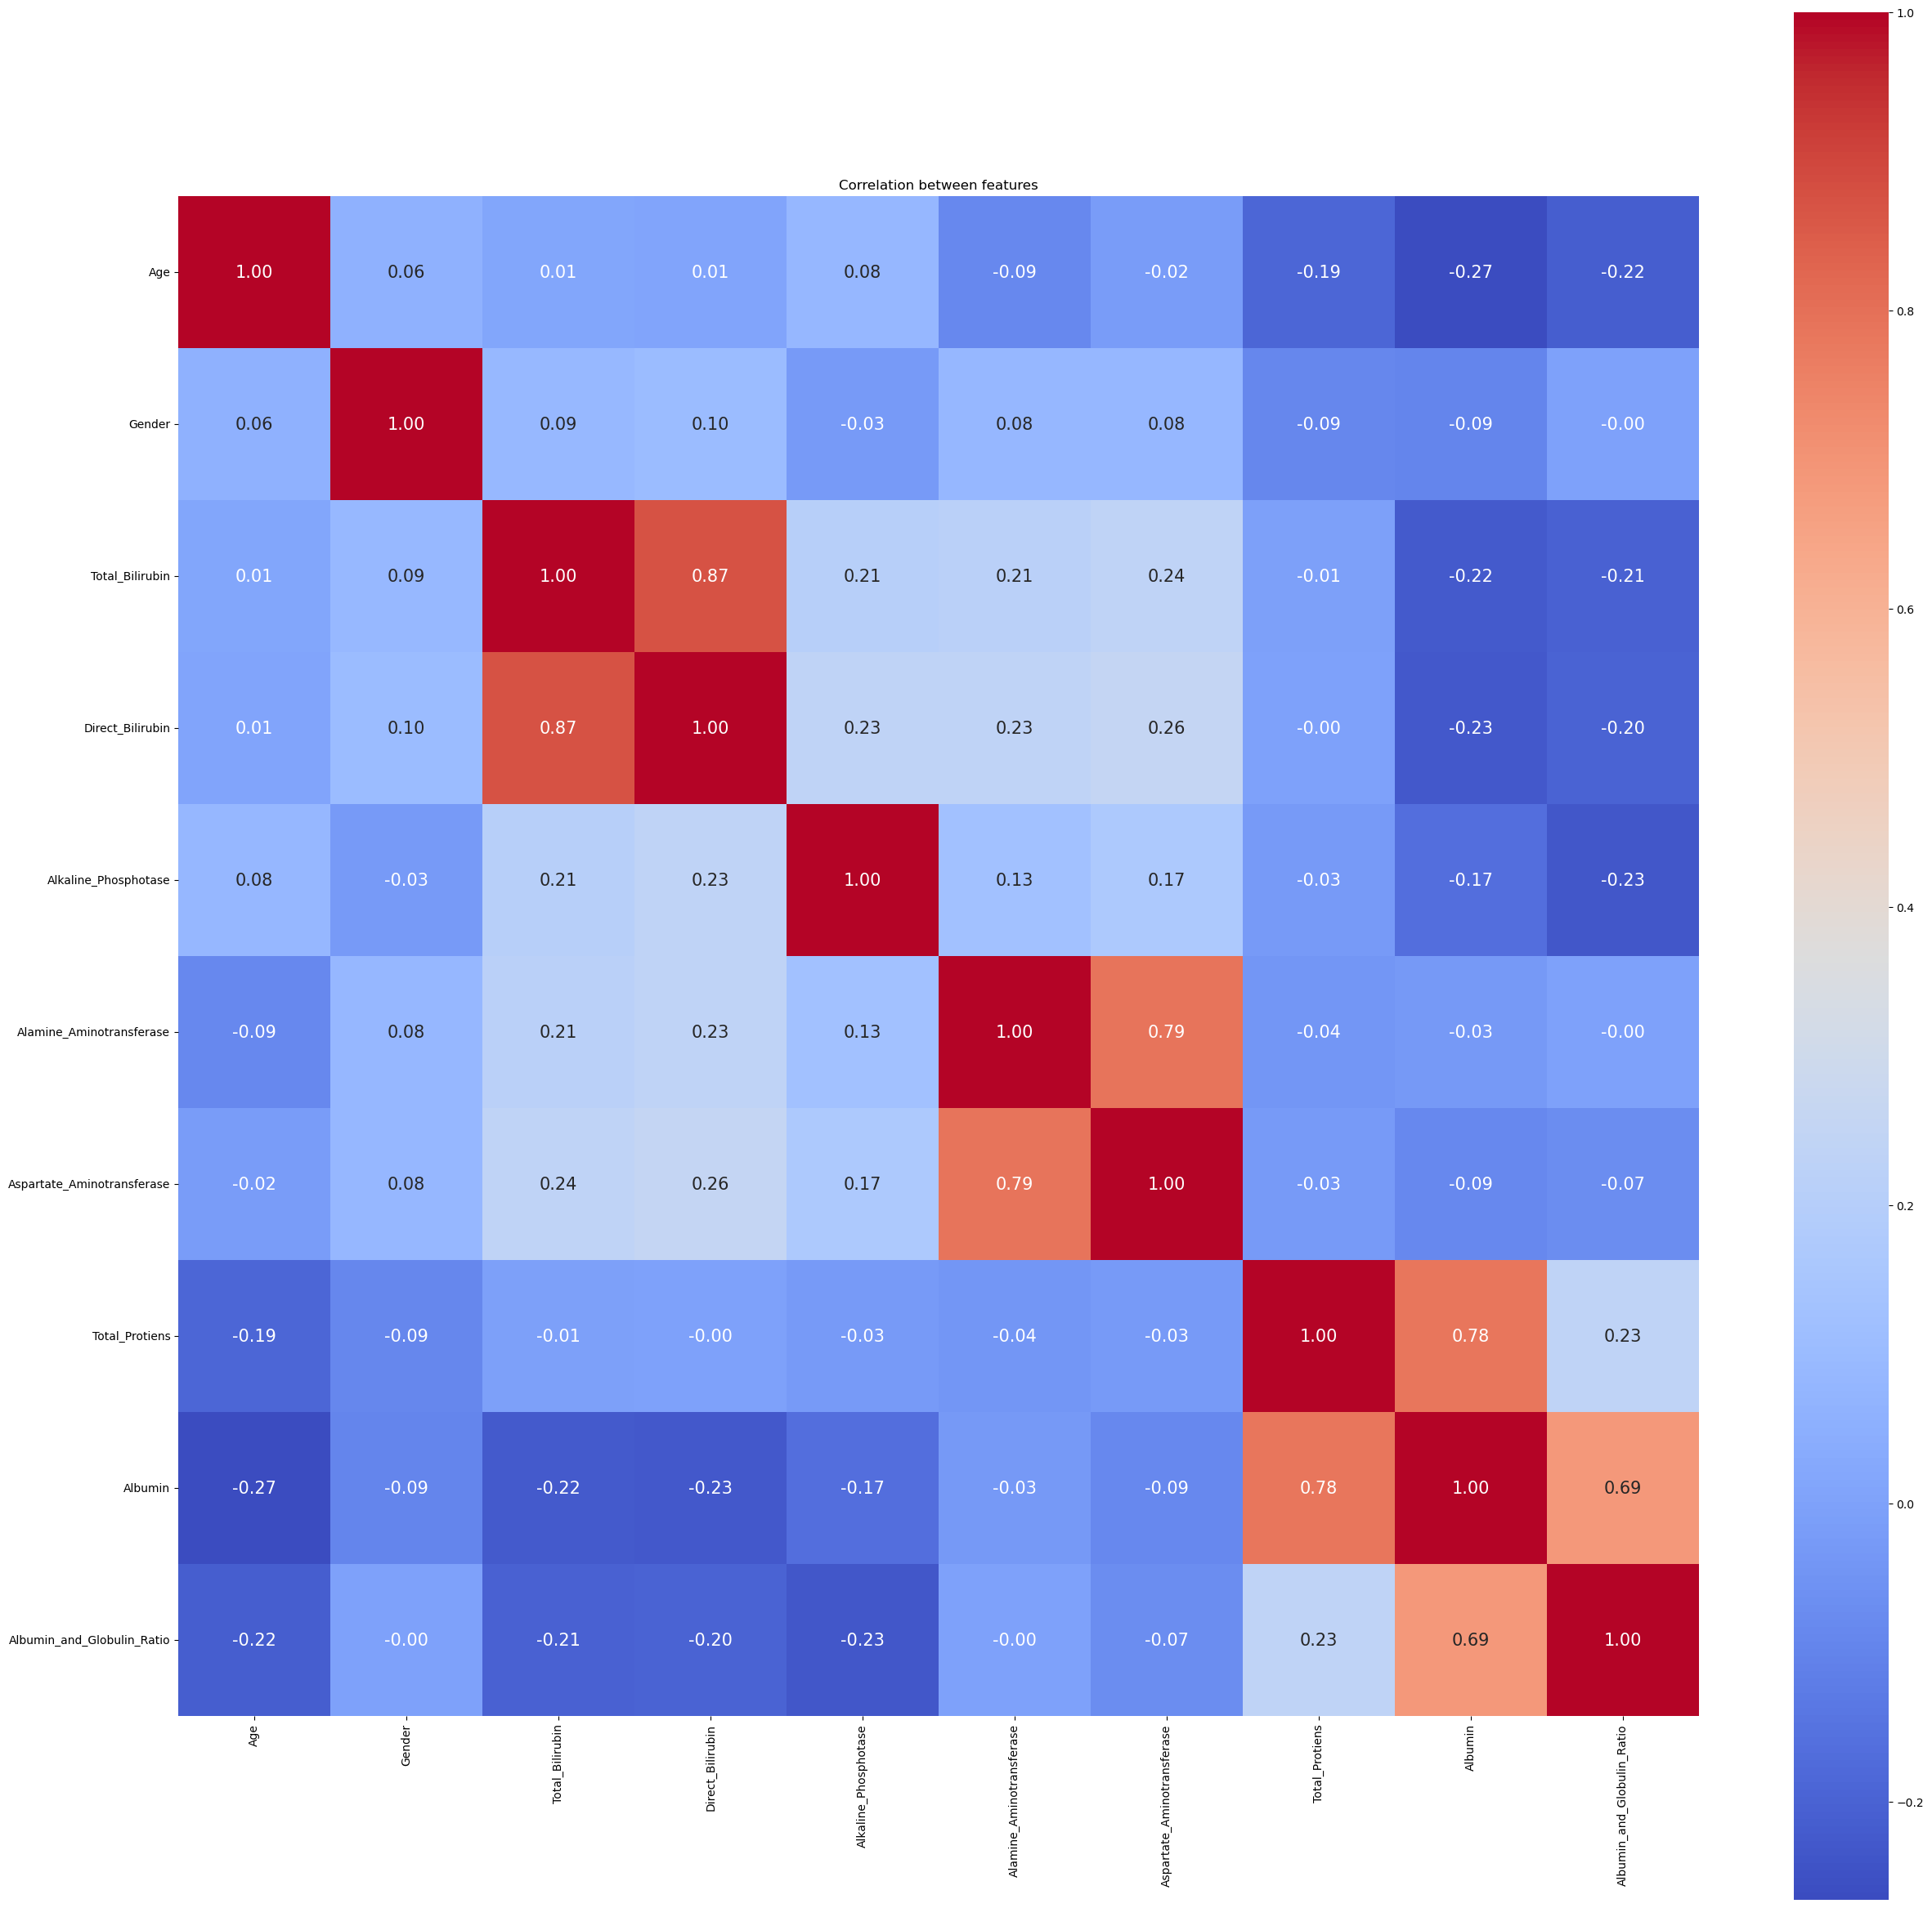
Creating a heatmap

Slide 14
Visualizing the data
As per the observations from visualization and HeatMap, there are relationships between the following features:
Direct Bilirubin and Total Bilirubin
Alamine Aminotransferase and Aspartate Aminotransferase
Total proteins and Albumin
Albumin and Albumin-Globulin Ratio
This might lead to multicollinearity and biased results due to dependence between the independent variables. Hence, the following features will only be kept for training:
Total Bilirubin
Alamine Aminotransferase
Total Protiens
Albumin and Globulin Ratio
Albumin

Slide 15
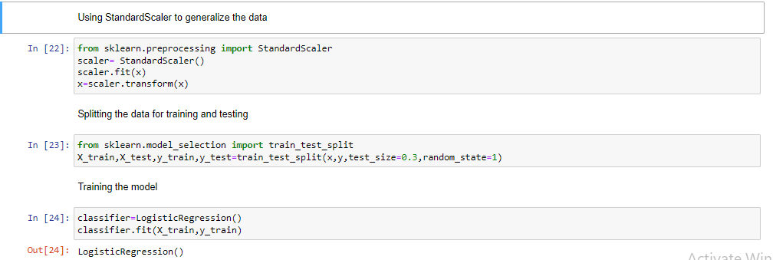
Logistic Regression

Slide 16
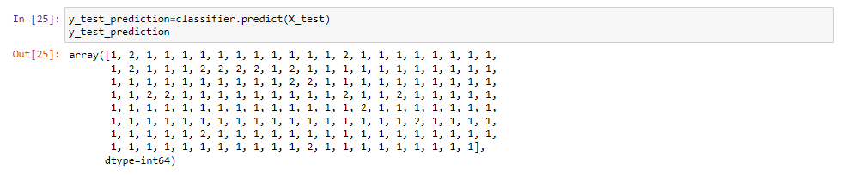
Running predictions on test data

Slide 17
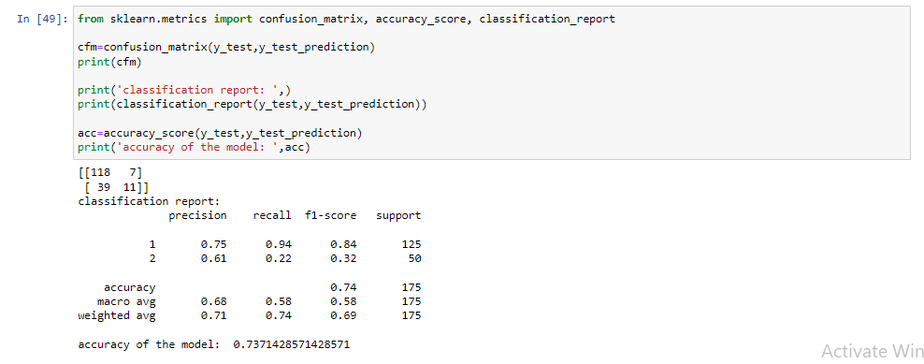
Model Evaluation

Slide 18
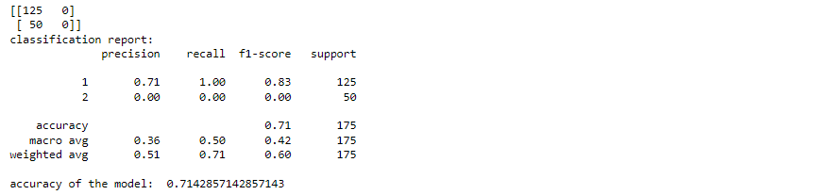
Results from Other Algorithms:
Decision Trees:
Random Forest:

Slide 19
Results from Other Algorithms:
AdaBoost Classifier:
SVC:

Slide 20
Conclusion:
As evident, Logistic Regression provides the best accuracy score without overfitting of the data. Whereas, all other algorithms have drawn the same accuracy with no error due to overfitting. Hence, the most appropriate algorithm for this model is Logistic Regression.

